Slide 1

Dr. B.P. Galhena
Dept. of Biochemistry and Clinical Chemistry

Slide 2
Functional roles of cholesterol
Essential component of cell membranes
Precursor of steroid hormones and bile salts
Precursor of vitamin D
Not required in the human diet because our cells can synthesize cholesterol de novo
Associated with atherogenesis
Notes:
Mavelonate independent pathway = great target for drug development

Slide 3
CHOLESTEROL SYNTHESIS, TRANSPORT, AND EXCRETION
Cholesterol is present in tissues and in plasma lipoproteins either as free cholesterol or, combined with a long-chain free fatty acid, as cholesteryl ester.
It is synthesized in many tissues from acetyl-çoA and is eliminated from the body in the bile as cholesterol or bile salts.
Liver plays central role in cholesterol hemeostasis
Cholesterol is the precursor of all other steroids, such as sex hormones, bile acids, and vitamin D.
It occurs in foods of animal origin such as egg yolk, meat, liver, and brain.

Slide 4
Determinants of Blood cholesterol level
Age : infancy adults males
Hormones: Insulin, Thyroid Hormones – synthesis
Oestrogen - catabolism
Diet: Dietary cholesterol – biosynthesis
Saturated fats- biosynthesis
Polyunsaturated fats– excretion, oxidation,
efflux from plasma to tissues
Blood cholesterol level
Fiber: cholesterol absorption, excretion by binding with bile salt

Slide 5
Cholesterol biosynthesis
Location of pathway
The pathway is located in the cytosol, beginning with acetyl-CoA.
Most cells can make cholesterol, but liver is most active.
Four stages (summary)
Condensation of 3 acetate units to mevalonate
Conversion of mevalonate into activated isoprene
Polymerization of six 5-carbon isoprene units (30 carbons) to form squalene
Cyclization of squalene to create the steroid nucleus

Slide 6
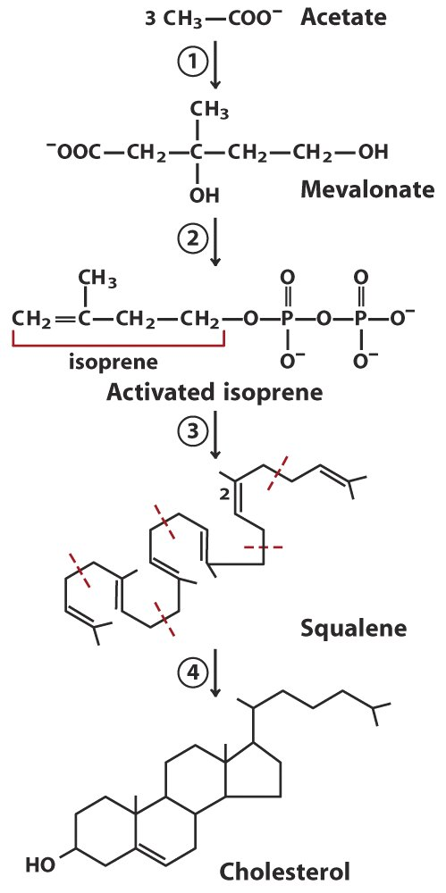
Four Stages of Cholesterol Biosynthesis

Slide 7
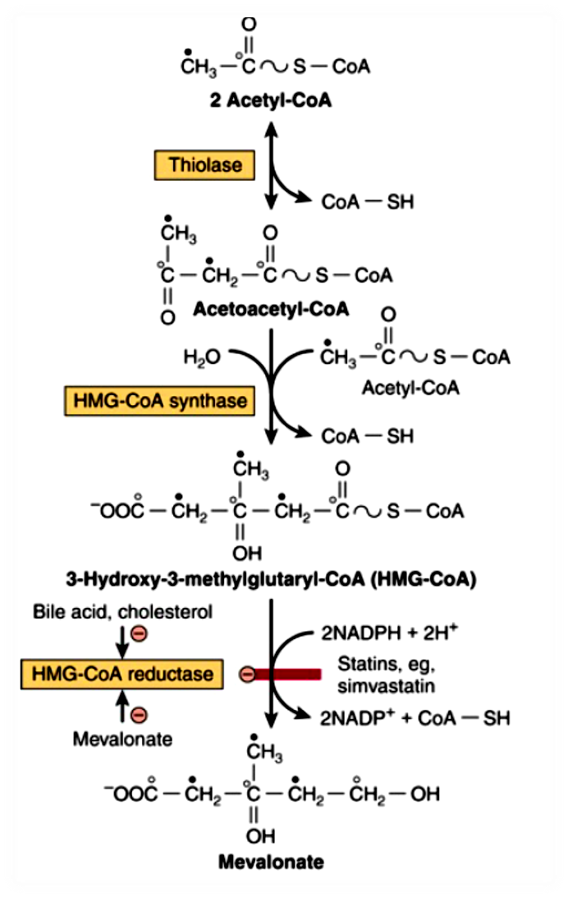
Overview of stage 1

Slide 8
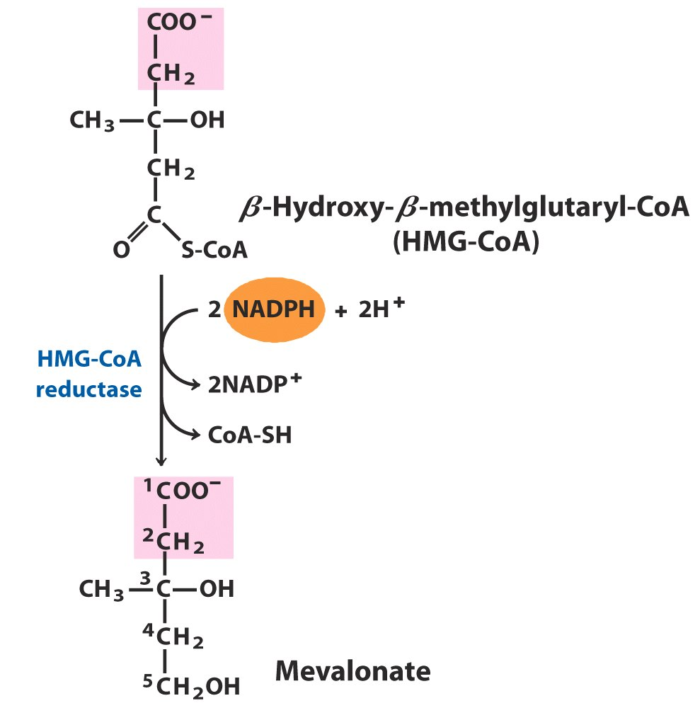
HMG-CoA Reductase
HMG-CoA reductase
integral membrane protein in the ER
different from mitochondrial HMG-CoA reductase, which plays a role in ketosis
carries out an irreversible reaction
is an important regulatory enzyme in cholesterol synthesis

Slide 9
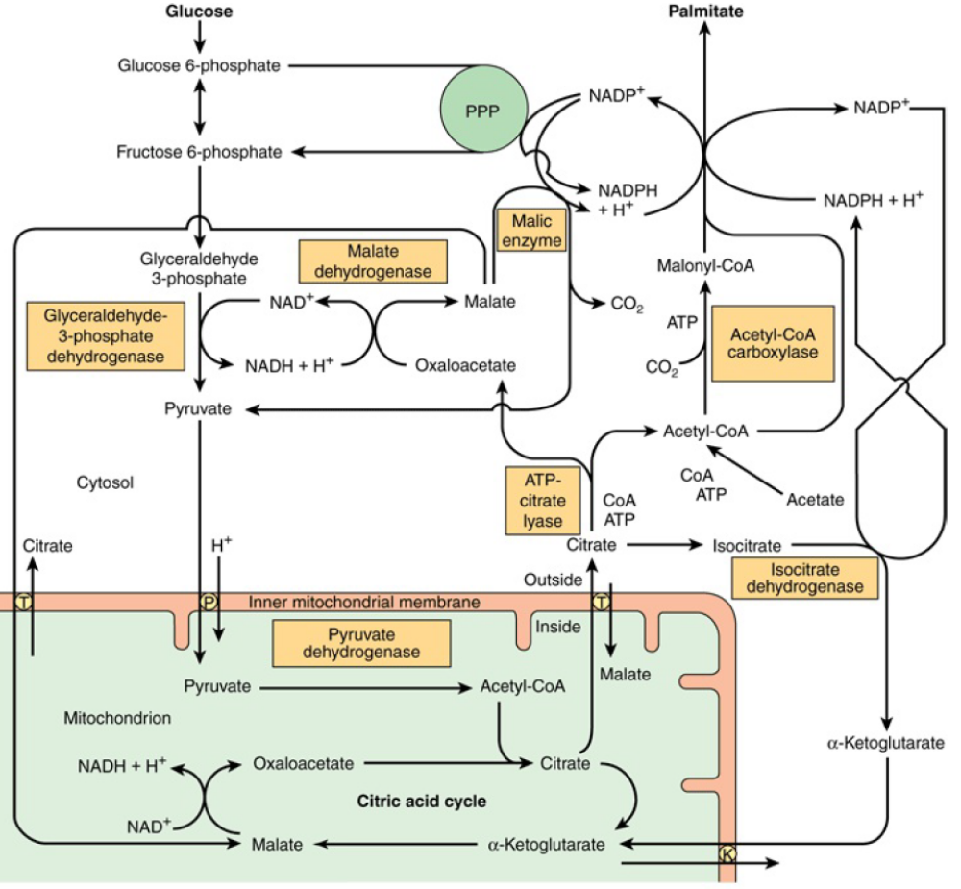
Translocation of Acetyl CoA

Slide 10
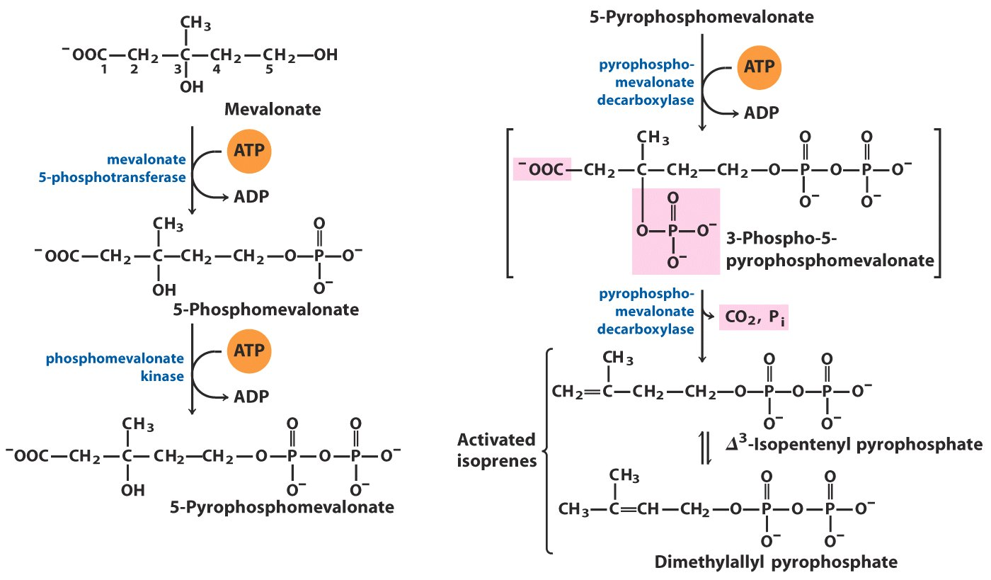
Overview of stage 2

Slide 11
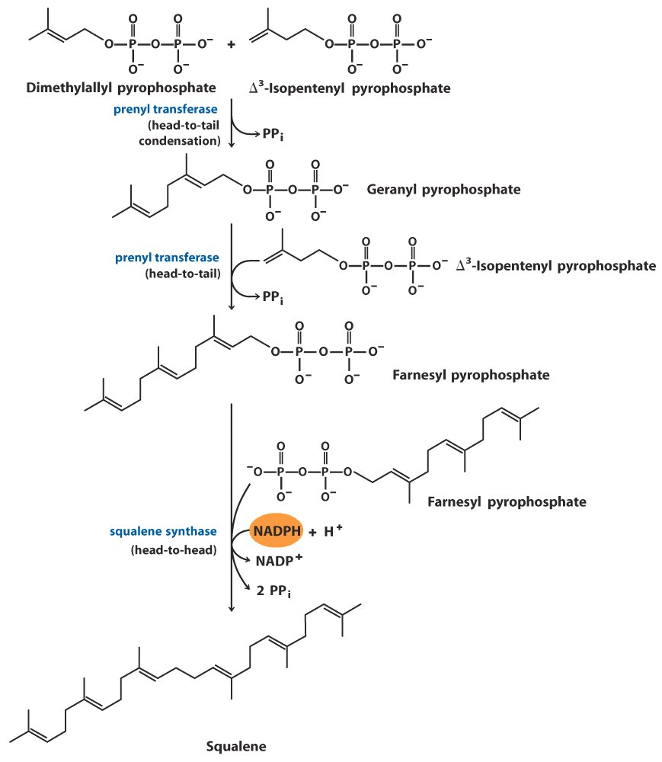
Overview of Stage 3

Slide 12
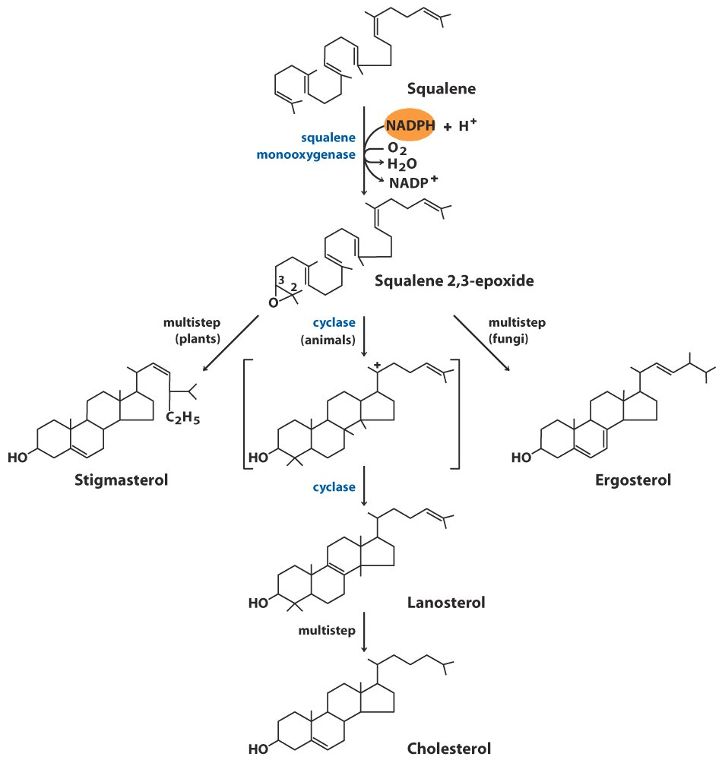
Overview of stage 4

Slide 13
Regulation of HMG CoA reductase
Short term regulation by reversible phosphorylation
Mediated by cAMP dependent protein kinases influenced by Insulin and Glucogen
Long term regulation by synthesis and degradation
Degradation is stimulated by derivatives of cholesterol.
Transcription is stimulated by a family of transcription factor : SREBP Sterol regulatory element binding protein which is secreted at low serum steroid level.

Slide 14
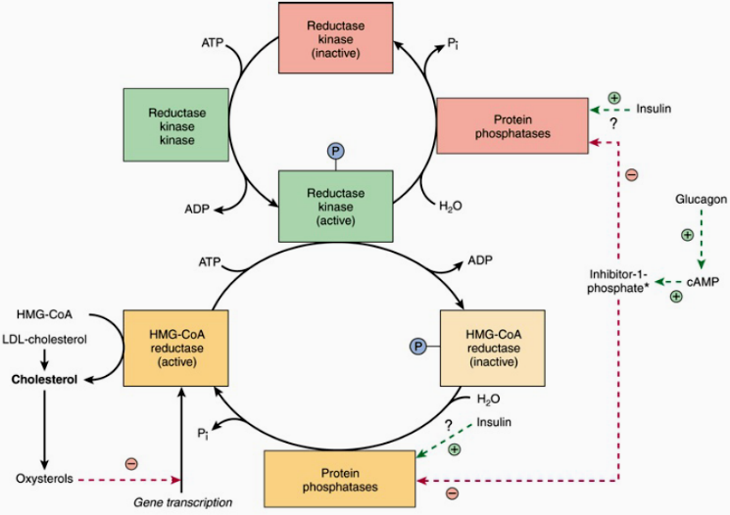
Overview of HMG CoA Reductase Regulation

Slide 15
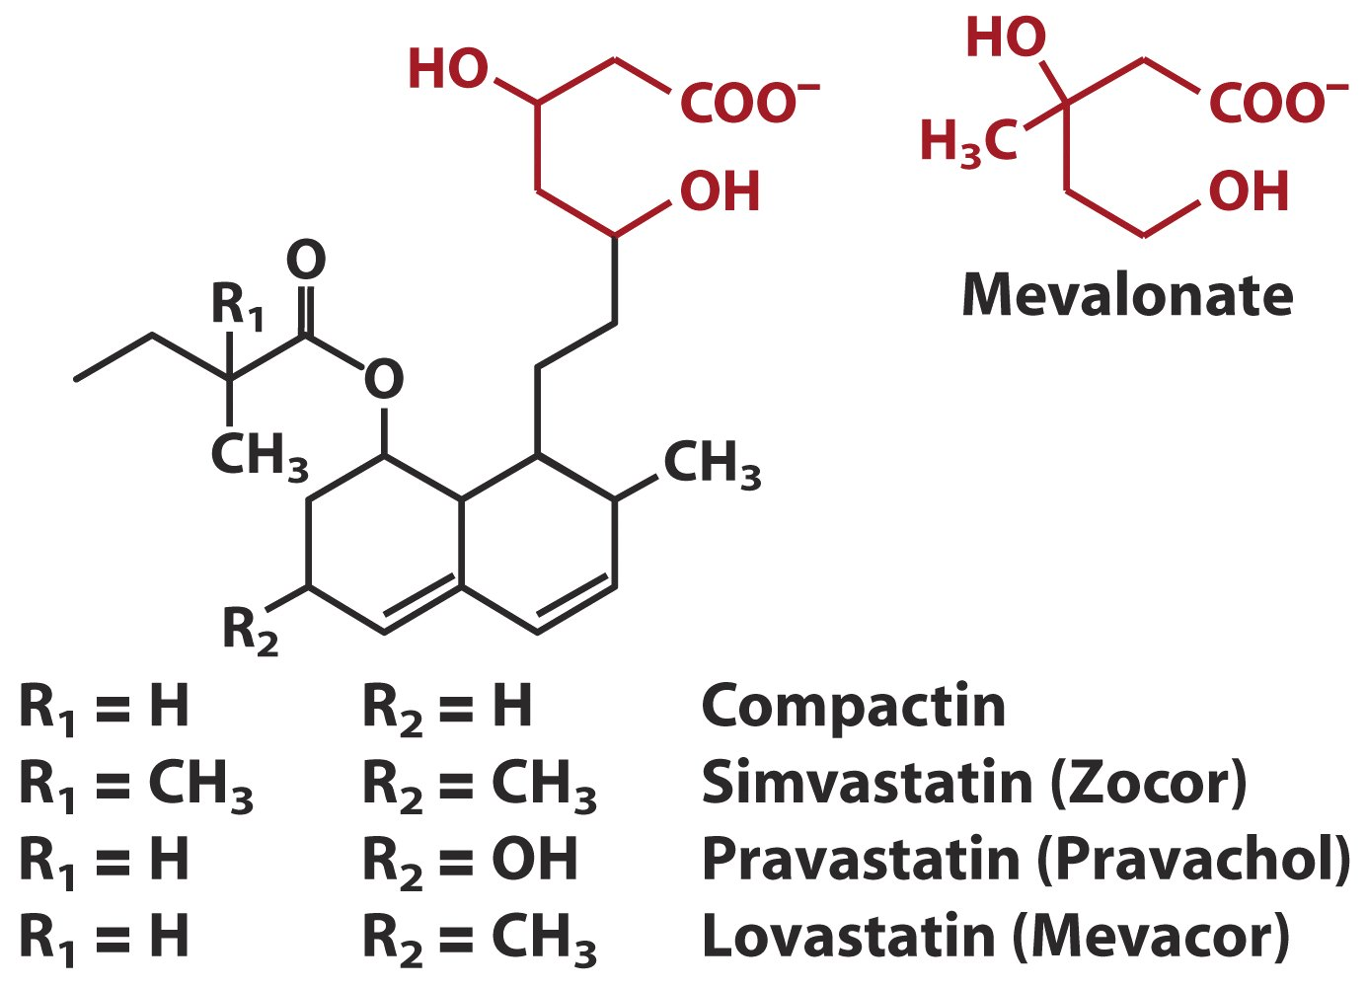
Competitive Inhibitors of HMG-CoA Reductase

Slide 16
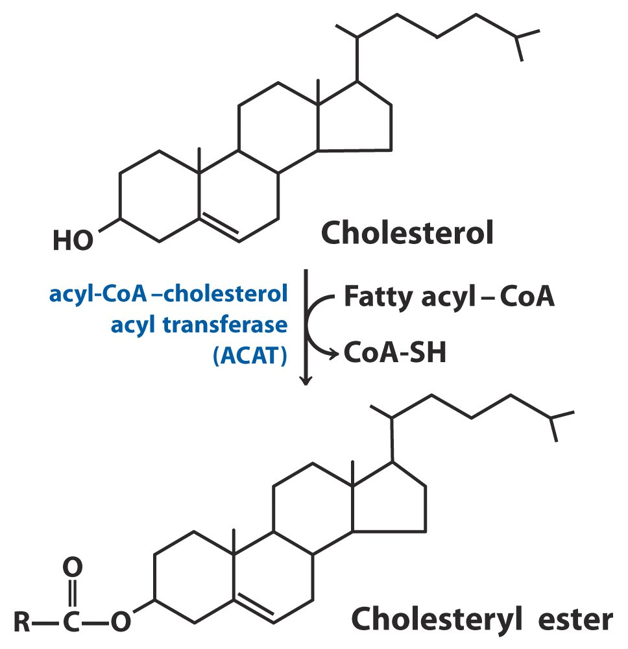
Synthesis of Cholesterol Esters

Slide 17
Export of Cholesterol Synthesized in Liver
Secretion into the small intestine via the bile fluid.
Conversion to bile acids followed by secretion into the small intestine in the bile fluid. (Bile acids function to emulsify dietary lipid.)
Conversion to cholesterol esters, packaging into lipoproteins and export into the blood (VLDL).

Slide 18
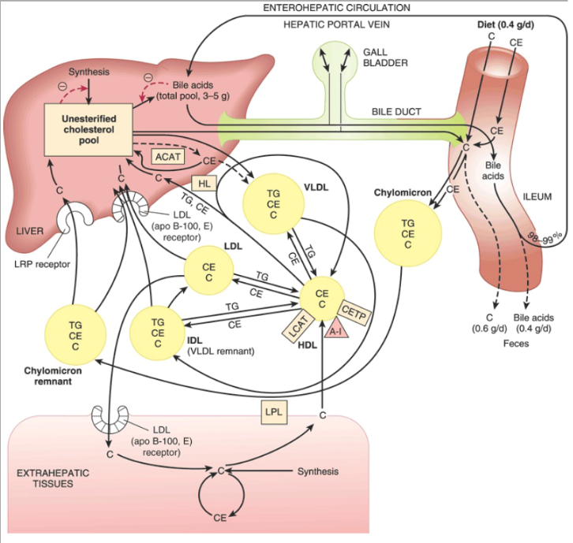

Slide 19
Bile acids are formed from cholesterol: Catabolism of Cholesterol
About 1 gram of cholesterol is eliminated from the body per day. Approximately half is excreted in the faces after conversion to bile acids. The remainder is excreted as cholesterol.
The primary bile acids are synthesized in the liver from cholesterol. These are cholic acid and chenodeoxycholic acid.
Primary bile acids becomes secondary bile acids due to bacterial action in the gut.

Slide 20
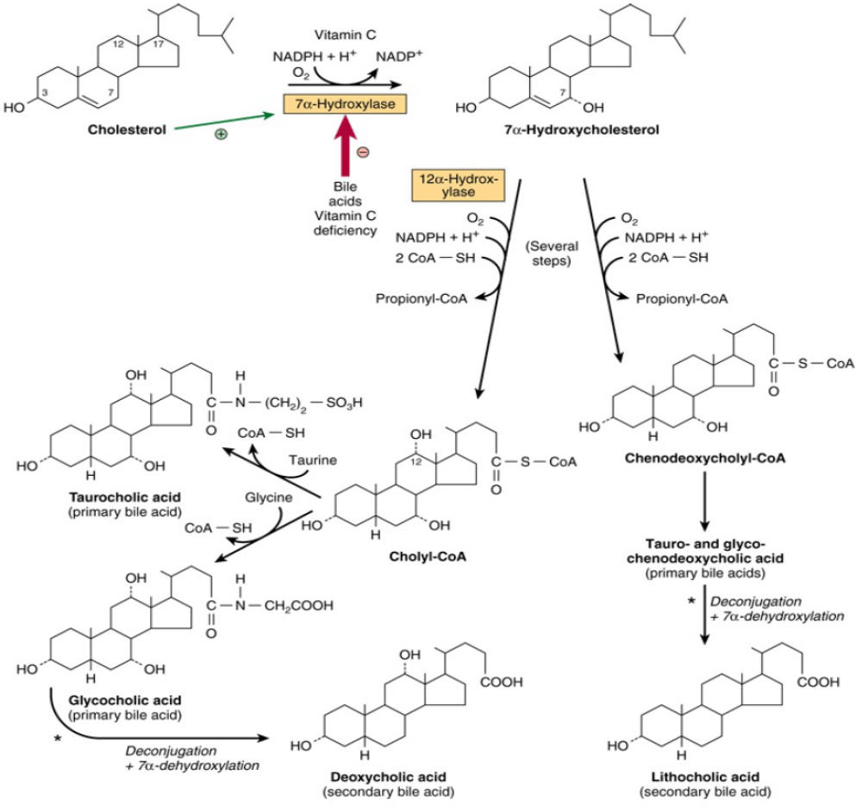

Slide 21
Properties of bile salts
Emulsification: Aids in digestion and absorption of dietary fat and fat-soluble vitamin.
Neutralization of acid specially in the GIT.
Excretion of cholesterol, drugs, toxins and bile pigments

Slide 22
Gall stones
Normal bile contains 5% cholesterol: 15% phospholipids: 80% bile salts.
If percentage of cholesterol increases or percentage of bile salt and phospholipids decrease
Cholesterol precipitate as stone
Cholelithiasis

Slide 23
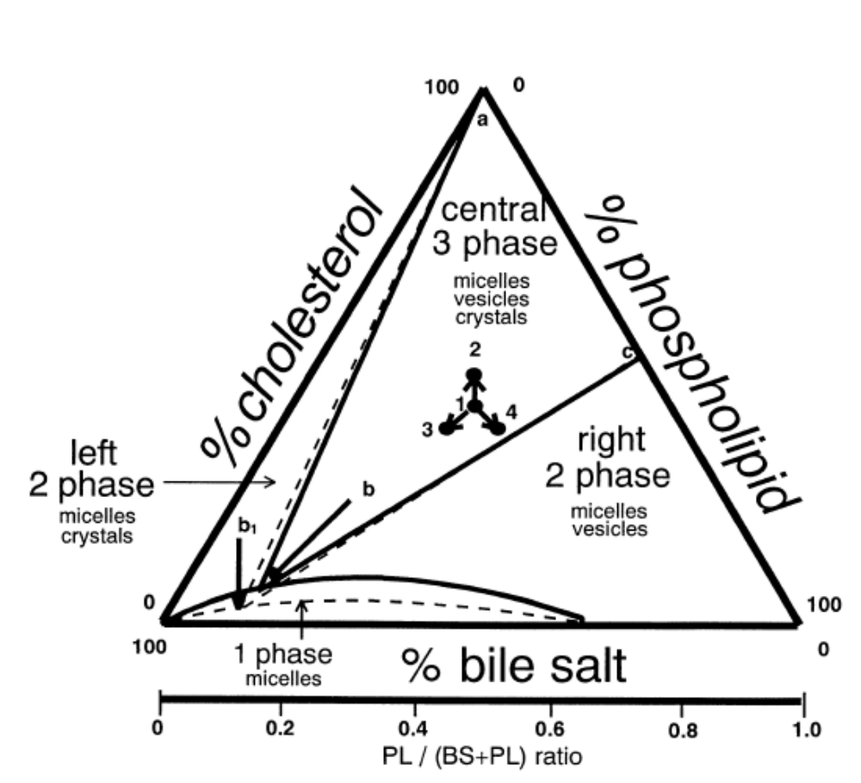
Cholesterol, phospholipid and bile salt in equilibrium

Slide 24
Causes of cholelithiasis
Gross malabsorption of bile acids from the intestine (ileal disease)
Decrease in bile acid synthesis (inhibition of 7 α hydorxylase activity)
Inhibition of bile salt (hepatic dysfunction)
Obstruction of billiary tract (Interruption of enterohepatic circulation)

Slide 25
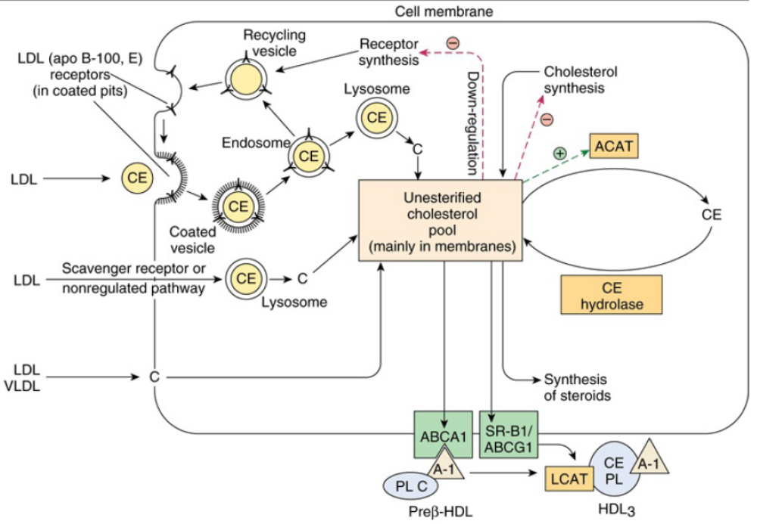
Cholesterol homeostasis at extra-hepatic tissues

Slide 26
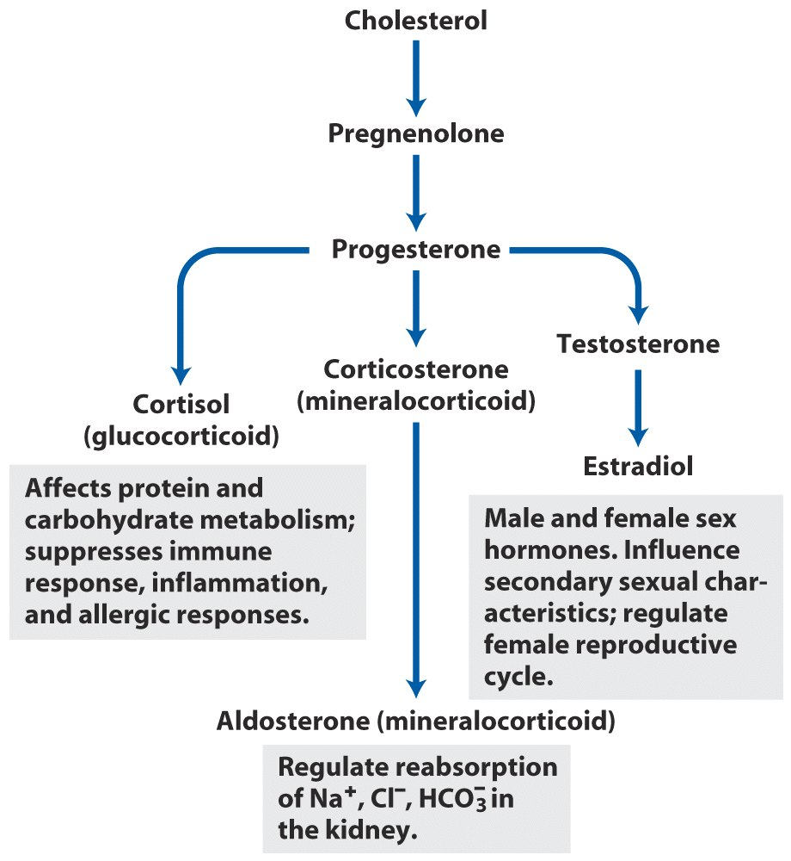
Steroid hormones synthesized by cholesterol

Slide 27
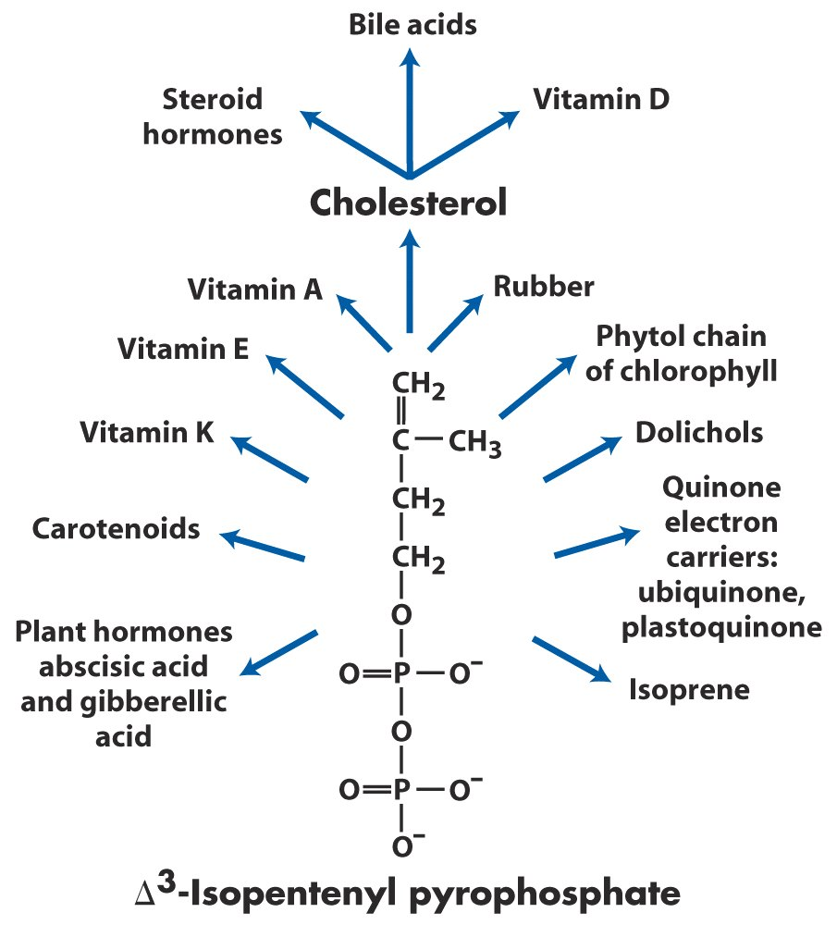
Natural Products Derived from Activated Isoprene Units

Slide 28


